Slide 1
Customer support-Automation of ticket creation
PIP104 University Project-II
Review-1
Batch Number: CCS-G31
Roll Number | Student Name
20211ccs0086 | Mohammad T
20211ccs0066 | Greeshma R
20211ccs0060 | Mubarak
20211ccs0054 | Vignesh G
20211ccs0041 | Mohammed Faizan
Under the Supervision of,
Professor: Dr. Syed Siraj Ahmed
School of Computer Science & Engineering
Presidency University

Slide 2
Introduction
Current Challenges in Ticket Management: Manual ticket processing struggles to keep up with the growing volume of customer complaints, leading to inefficiencies, slow response times, and poor customer satisfaction.
Proposed Solution: By leveraging Artificial Intelligence (AI) and Natural Language Processing (NLP), the system automates ticket generation, classification, and response handling, drastically reducing human intervention and errors.
Advanced Technologies: Incorporating cutting-edge tools such as LangChain, LangGraph, and Retrieval-Augmented Generation (RAG), the system intelligently retrieves relevant information, generates accurate responses, and scales to meet high demand.
Key Benefits: Faster resolution times, improved customer experience, and scalable operations, allowing customer service teams to focus on complex issues rather than routine ticket handling.

Slide 3
Literature Review
Ticket Sorting based on the problem in the Ticket(i.e, Personal, Educational, Support, Product, etc).
Response for unknown/unsupervised Problems (Using an AI).
Ticket translation incase of Ticket’s generated in other languages.
Enhanced customer support by increasing efficiency ( ~10%).
LLM and RAG to improve the Quality and accuracy of response email.
Technical Support Automation in case it fails it forwards it for human intervention to satisfy customer needs.
Integration with existing AI.
Parallel Processing to increase efficiency

Slide 4
Proposed Method
AI-Driven: This emphasizes the use of AI models and natural language processing (NLP) techniques,
including machine learning (ML) models, to automate ticket generation and responses based on incoming emails.
Retrieval-Augmented Generation (RAG): Refers to enhancing the process by retrieving relevant information from a large set of documents (e.g., previous tickets, customer queries) to generate informed responses or guide the agent's actions.
LangChain & LangGraph: These frameworks allow for better chaining of language models (like GPT) and efficient graph-based
workflows. This could enable handling multiple parallel processes and complex decision-making, like automatically updating tickets
based on email contents and customer responses.

Slide 5
Objectives
AI-powered automated ticketing system that leverages advanced natural language processing (NLP), retrieval-augmented generation (RAG), and multi-step workflow automation frameworks to streamline customer complaint handling. This system aims to:
Automate Ticket Creation: By parsing customer complaint emails, the system automatically generates tickets with relevant details, reducing manual intervention.
Enhance Accuracy through Retrieval-Augmented Generation (RAG): Implement RAG techniques to retrieve relevant historical ticket data and generate accurate responses or solutions based on previous case resolutions.
Optimize Workflow with LangChain and LangGraph: Employ LangChain and LangGraph to orchestrate multi-step, complex decision-making processes, enabling tasks such as automatic email follow-ups for incomplete ticket data and intelligent routing of tickets based on sentiment and urgency.
Parallel Processing for Scalability: Integrate parallel processing to handle large volumes of incoming complaints and queries efficiently, ensuring the system remains scalable as the workload increases.
Improve Customer Experience: Implement AI-based tools to prioritize tickets through sentiment analysis and provide timely, contextually accurate responses, resulting in faster resolution times and improved customer satisfaction.

Slide 6
Methodology
Step 1: Email Parsing and Ticket Creation Use Natural Language Processing (NLP) to parse incoming emails, extracting key details (customer ID, issue type, etc.) and automatically generate tickets.
Step 2: Retrieval-Augmented Generation (RAG) Implement RAG to retrieve relevant information from historical tickets, enhancing the response by referencing similar issues and their resolutions.
Step 3: LangChain and LangGraph for Workflow Automation Utilize LangChain and LangGraph frameworks to manage multi-step workflows, such as follow-ups for incomplete ticket details, ticket routing, and auto-responses based on predefined templates.
Step 4: Parallel Processing for Scalability Deploy parallel processing techniques to manage multiple queries simultaneously, ensuring the system scales with increasing ticket volume without compromising speed or accuracy.

Slide 7
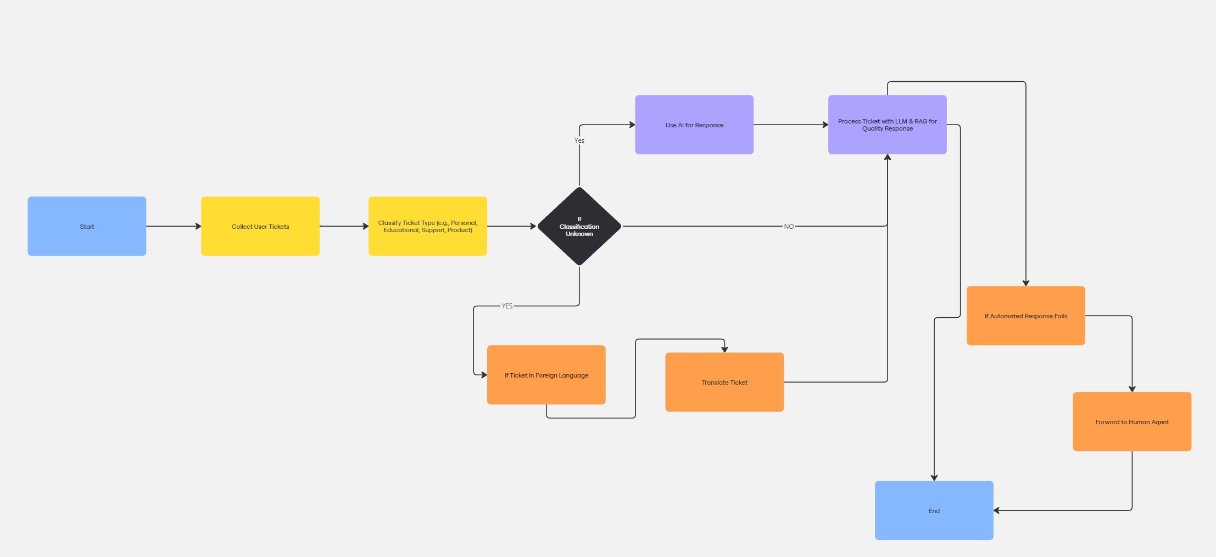

Slide 8
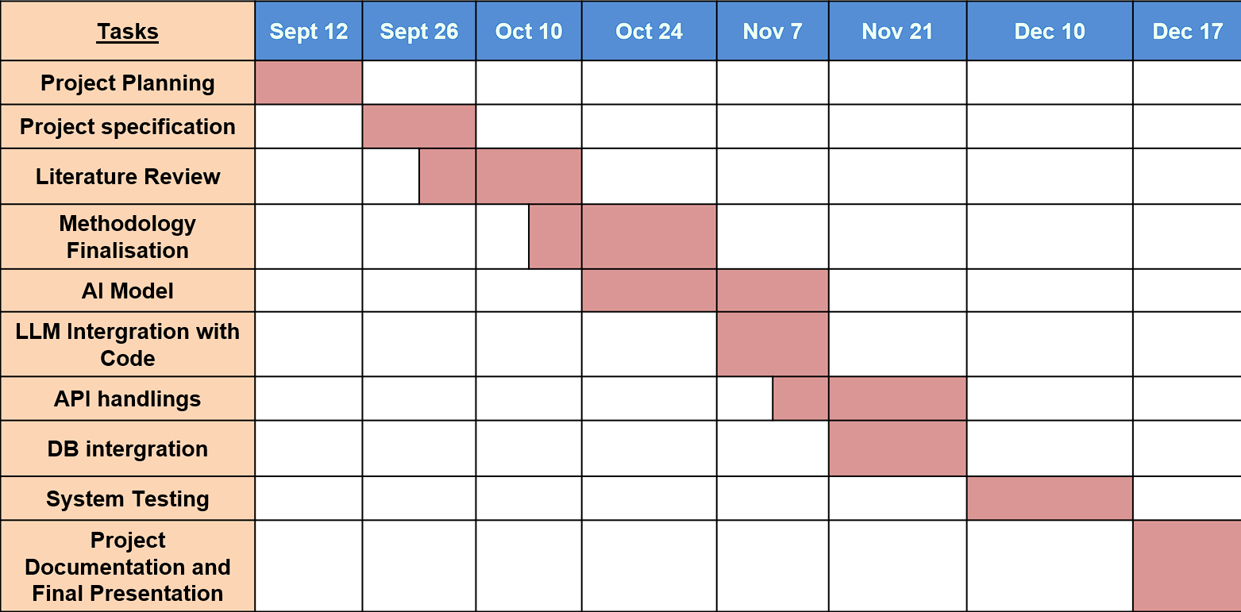
Timeline of Project

Slide 9
Expected Outcomes
Efficiency Gains: Automated ticket creation and workflow reduces manual intervention, speeding up operations.
Faster Resolution: RAG and sentiment analysis prioritize urgent tickets, delivering quick, accurate responses.
Scalability: Parallel processing allows the system to handle high volumes seamlessly.
Enhanced Customer Experience: Faster responses and personalized solutions lead to higher satisfaction.
Cost Reduction: Fewer human agents needed due to automation, lowering operational costs.
Data Insights: Valuable analytics on ticket trends and system performance for continuous improvement

Slide 10
Conclusion
Advanced AI Integration By leveraging LangChain, LangGraph, and RAG, this system effectively automates ticket creation, routing, and resolution, minimizing manual workload.
Seamless Customer Experience The use of NLP and Sentiment Analysis ensures that customer complaints are prioritized and handled with personalized, accurate responses.
Scalability and Efficiency Parallel processing enables the system to handle high volumes of tickets simultaneously, ensuring smooth scalability as demand grows.
Intelligent Automation The system automatically handles follow-up tasks, retrieves historical data, and processes template-based responses, leading to faster ticket resolution.
Operational Cost Reduction Reduced reliance on manual processing means fewer support staff are needed, significantly lowering operational costs while maintaining high service quality.
Actionable Insights Through AI-driven analytics, the system provides valuable insights on ticket trends, enabling continuous improvement and enhanced decision-making

Slide 11
References
https://www.researchgate.net/publication/337509813_A_Study_in_the_Automation_of_Service_Ticket_Recognition_using_Natural_Language_Processing
https://ieeexplore.ieee.org/ielx7/6287639/8948470/09234428.pdf
https://jcoms.fesb.unist.hr/pdfs/v17n1_1024_tolciu.pdf
https://www.researchgate.net/publication/337509813_A_Study_in_the_Automation_of_Service_Ticket_Recognition_using_Natural_Language_Processing
https://www.researchgate.net/publication/339986693_AI-based_chatbots_in_customer_service_and_their_effects_on_user_compliance
https://www.researchgate.net/publication/381461839_Retrieval_Augmented_Generation_RAG_based_Restaurant_Chatbot_with_AI_Testability
https://www.scitepress.org/Papers/2024/128072/128072.pdf
https://www.researchgate.net/publication/381036706_Application_of_Chatbots_and_Virtual_Assistants_in_Ticket_Booking_System
https://www.sciencedirect.com/science/article/abs/pii/S1567422321000703https://www.researchgate.net/publication/371057143_Design_and_Implementation_of_an_AI_Chatbot_for_Customer_Service
https://www.emerald.com/insight/content/doi/10.1108/REGE-07-2021-0120/full/html
https://ceur-ws.org/Vol-3239/paper17.pdf
https://www.darpa.mil/attachments/AIFull.pdf

Slide 12
Thank You

